Slide 1


22ECW351: Project lab-II
(VI Semester)
Department of Electronics and Communication Engineering
Presented By : Devashish Tushar
(2022uec1487)
MNIT Jaipur

Slide 2
1
Microstrip Patch Antenna :
Multiband Application
- for Ku, K and Ka Band(12GHz - 18 GHz ; 18GHz - 26.5GHz ; 26.5GHz - 40GHz) application
This presentation details the design and simulation of a microstrip patch antenna, specifically for Ku band(12 GHz to 18 GHz), K band(18 GHz to 26.5 GHz) and Ka band(26.5 GHz to 40 GHz) applications, using CST Studio Suite software..
MNIT Jaipur

Slide 3
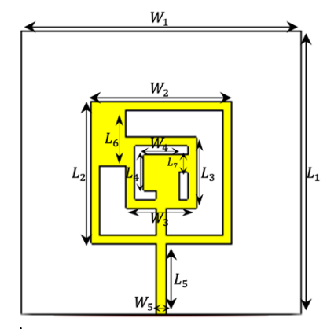
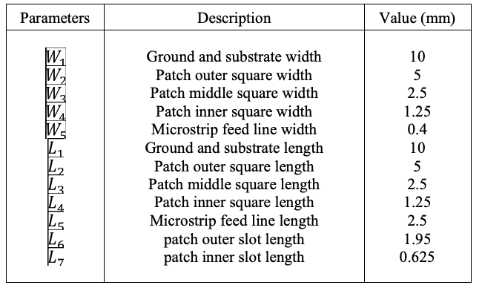
2
DESIGN SPECIFICATIONS
MNIT Jaipur

Slide 4
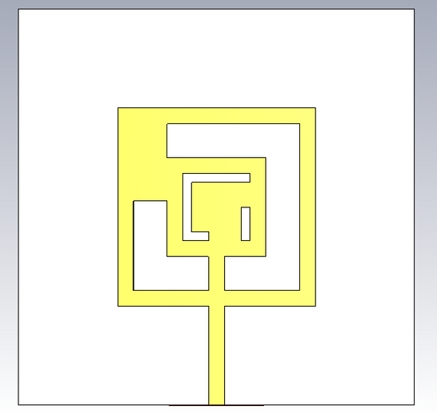

3
Antenna Design Overview
  Substrate: FR4 (εr = 4.3, tanδ = 0.025)
  Substrate Thickness: 1 mm
  Antenna Size: 10 mm × 10 mm
Patch Geometry
  Outer Patch: 5 × 5 mm
  Middle Patch: 2.5 × 2.5 mm
  Inner Patch: 1.25 × 1.25 mm
Front view
Slot Dimensions
  Outer–Middle Slot: 0.95 × 1.95 mm
  Middle–Inner Slot 1: 0.325 × 0.625 mm
  Middle–Inner Slot 2: 0.425 × 0.325 mm
Feeding Technique
  Type: Microstrip Line Feed
  Dimensions: 0.4 mm (W) × 2.5 mm (L)
  Placement: Centered, 2.5 mm from patch
Back View
MNIT Jaipur

Slide 5
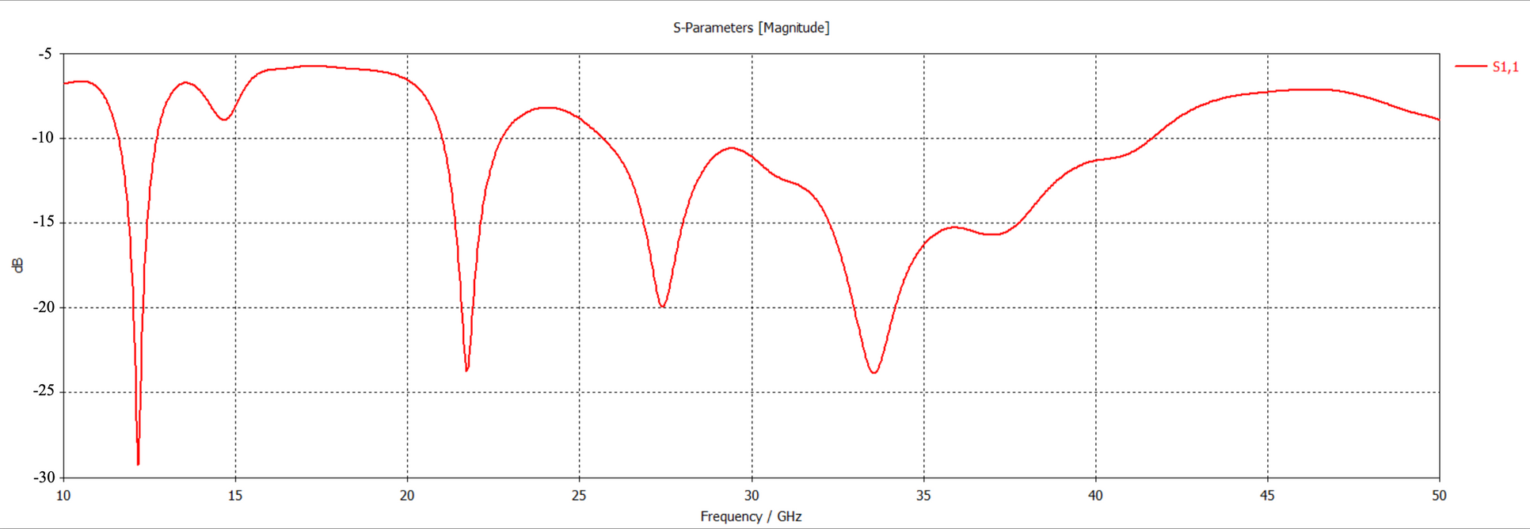
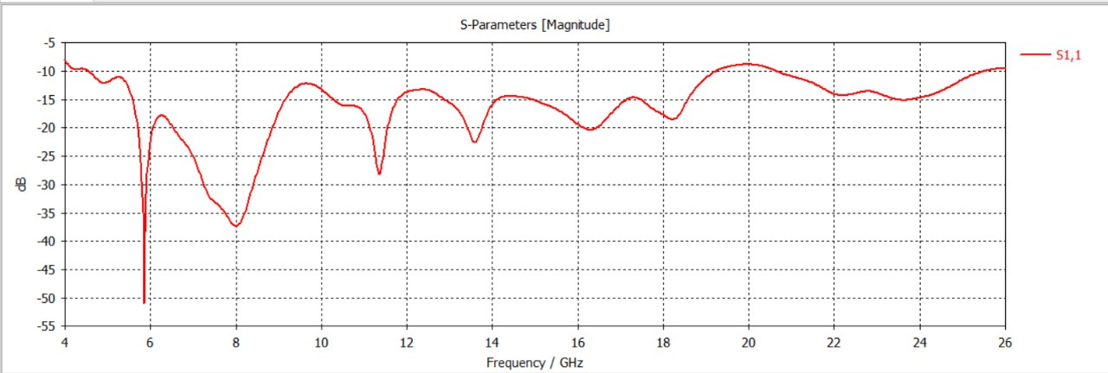
5
RESULTS
Desirable frequency Bands are obtained ->11.5–12.8 GHz, 21–22.74 GHz, and 25.6–41 GHz,

Slide 6
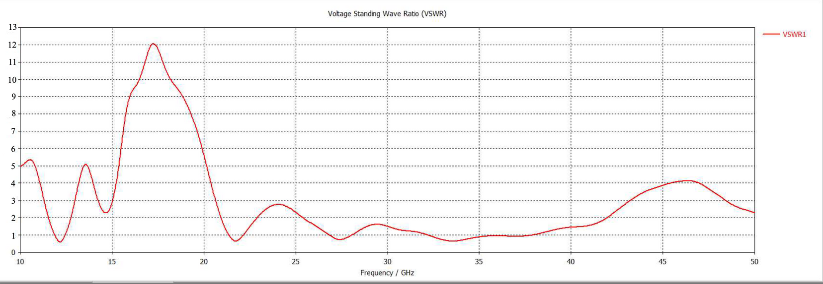
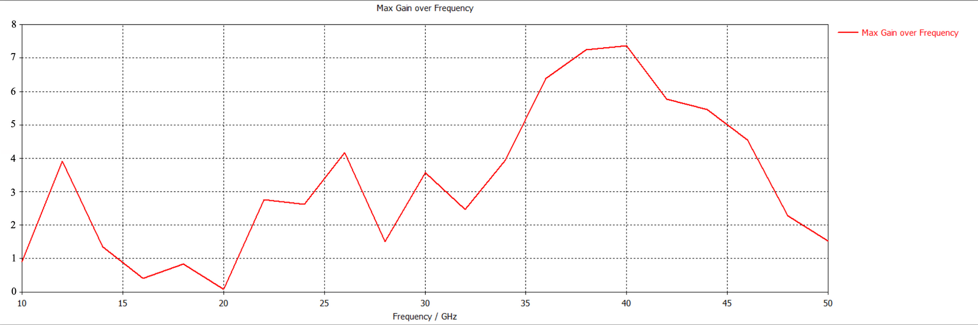
6
VSWR
Max Gain over Frequency
Max Gain of 7.4 dBi observed at 39.87 GHz
MNIT Jaipur

Slide 7
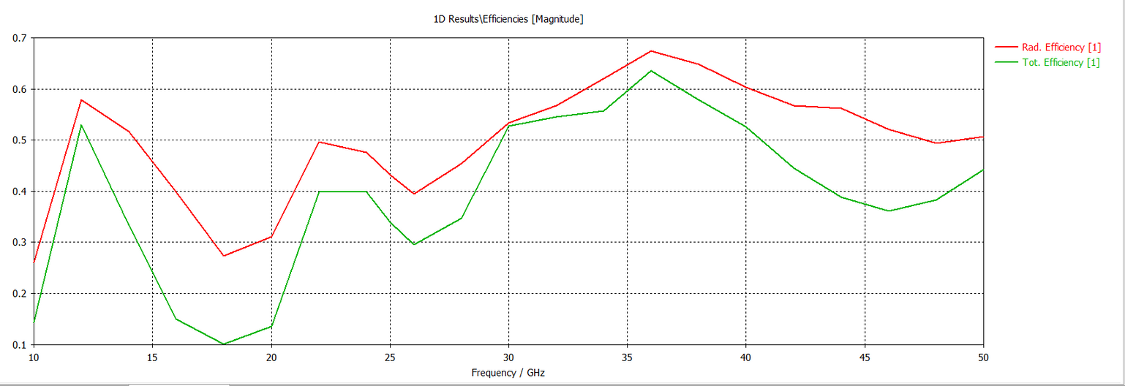
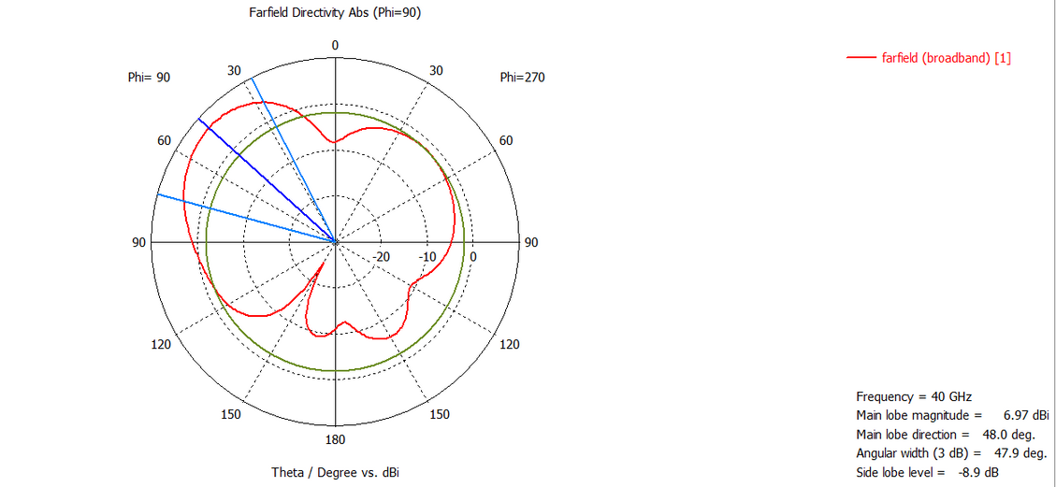
6
Efficiency
The antenna achieves peak radiation and total efficiencies of
approximately 66% and 63% respectively around 36 GHz
Directivity
MNIT Jaipur

Slide 8
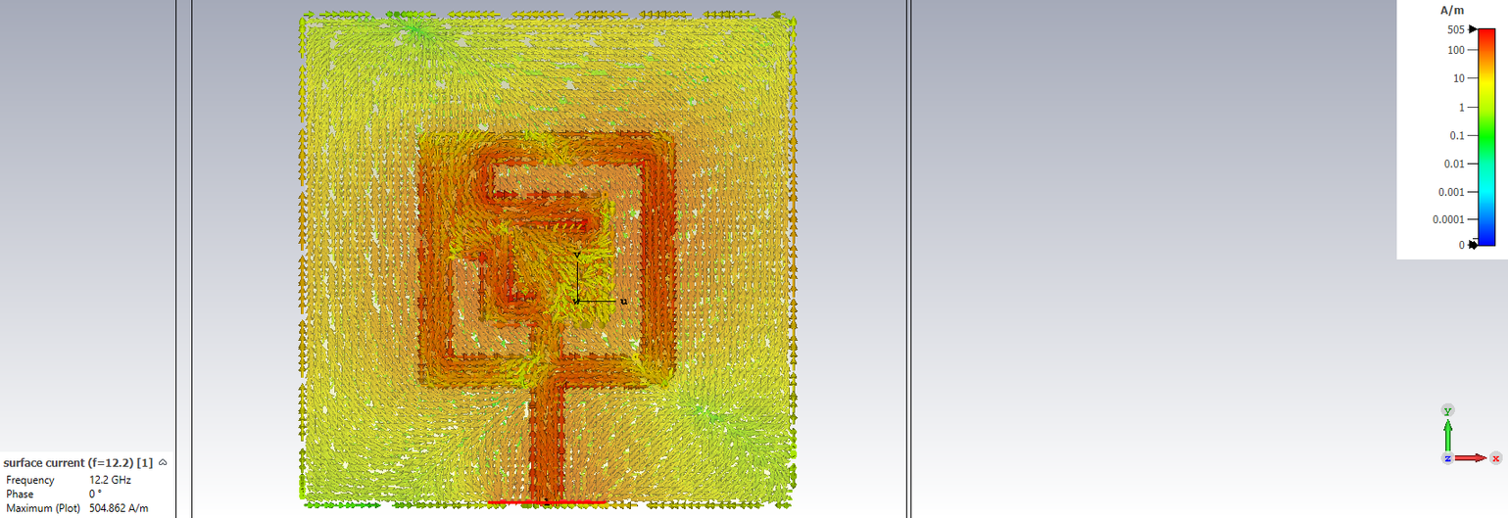
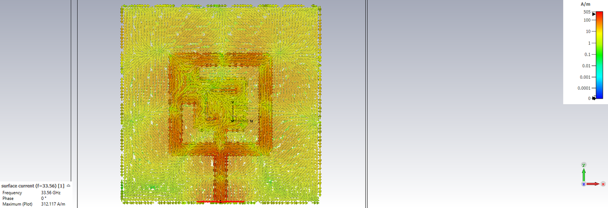
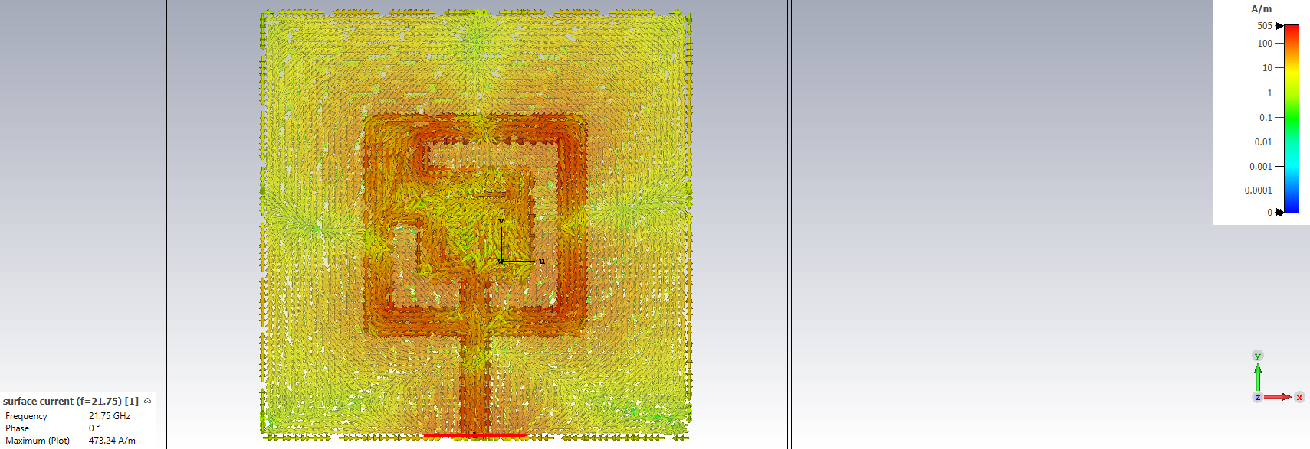
Surface Current
6
12.2 GHz
33.56 GHz
21.75 GHz
MNIT Jaipur

Slide 9
8
CONCLUSION
A compact multiband microstrip patch antenna was successfully designed and simulated for Ku, K, and Ka bands (11.58–41.65 GHz), targeting applications like satellite broadcasting, RADAR, inter-satellite links, and 5G. The square patch with concentric slots achieved excellent return loss (as low as −29.35 dB), VSWR near 1, and multiband resonance. Simulated in CST, the antenna showed a peak gain of 8.3 dBi at 39.87 GHz and efficiencies of 66% (radiation) and 63% (total). The design proves highly effective for high-frequency communication and satellite systems.
MNIT Jaipur

Slide 10
THANK YOU

